Slide 2








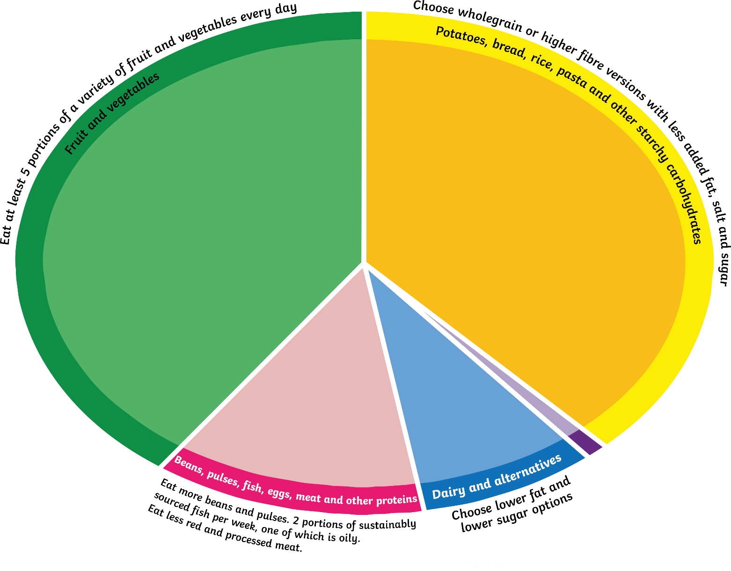

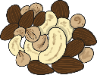




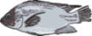



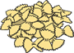

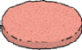

yoghurt
broccoli
crisps
lettuce
chick peas
bagel
bread
apple
strawberry
butter
nuts
peas
carrot
potatoes
tomato
rice
cucumber
fish
oil
cereal
banana
Oil & spreads
burger
pasta
egg
For more information, visit Eatwell Guide
cheese
pepper

